Slide 1


Data Scientist/Analyst
Real Estate Sales 2001 – 2020
Presentation by
Andy Joseph
View Slides

Slide 2
Exploring Property Assessment and Sales Data for Informed Decision-Making
Data Scientist/Analyst
01 - Assessment Accuracy
Problem Statement
02 – Market Trends
Objectives
03 – Geographical Analysis
View Slides

Slide 3
Objectives
Data Scientist/Analyst
04 – Property Type Impact
05 – Non – Use Code Insights
View Slides
06 – Assessor and OPM Remarks

Slide 4
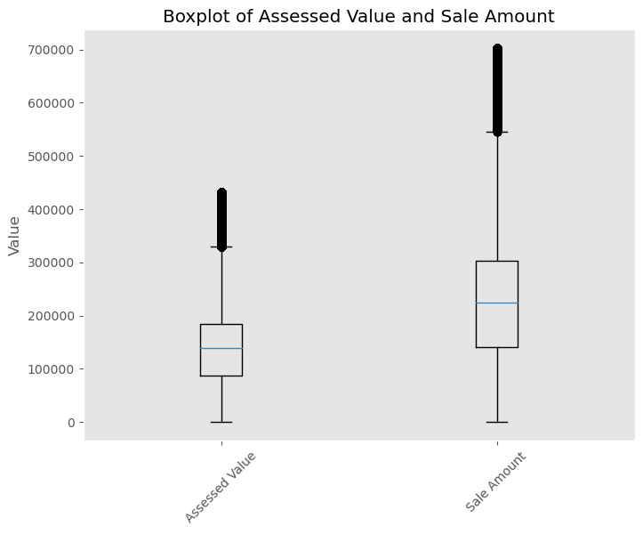
1. Evaluating the accuracy of property assessments by comparing assessed values with actual sale amounts and identify any discrepancies.
The mean Assessed Value stands at $145,606, while the mean Sale Amount is notably higher at $236,515, indicating the average transaction price for these properties. Also, The maximum Assessed Value reaches $432,500, while the maximum Sale Amount peaks at $702,500, showcasing the upper limits of property values and transaction prices.
Descriptive Analysis
Data Scientist/Analyst

Slide 5
Exploring Significance Discrepancies
ID (Sample) | Assessed Value($) | Sale Amount($) | Difference($)
641553 | 138390.0 | 525000.0 | 386610.0
443636 | 107180.0 | 215000.0 | 107820.0
738333 | 72590.0 | 75000.0 | 2410.0
896519 | 137000.0 | 237000.0 | 100000.0
251533 | 79980.0 | 145000.0 | 65020.0

Slide 6
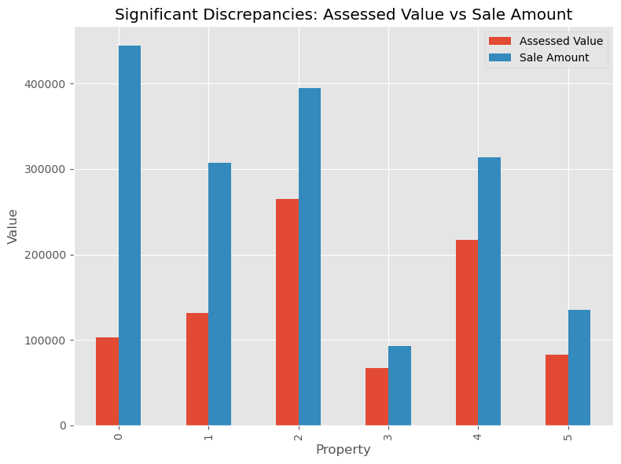
Exploring Significant Discrepancies
Insights (Sampled Dataset) Properties such as #641553 and #443636 show substantial differences between their assessed values and sale amounts, suggesting possible inaccuracies in the valuation process. Financial Impact: The discrepancies, like the 386,610 difference in property 641553, can have a substantial financial impact on property owners, buyers, and tax assessments. Market Perception: Significant differences between assessed values and sale amounts may influence market perceptions of property values, impacting buying decisions and market dynamics.
Data Scientist/Analyst

Slide 7
Recommendations
Data Scientist/Analyst
Review Process: Implementing a thorough review process to identify and rectify discrepancies in assessed values can enhance the reliability of property valuations.
Training and Guidelines: Providing assessors with training on valuation methodologies and guidelines for accurate assessments can help mitigate errors and discrepancies.

Slide 8
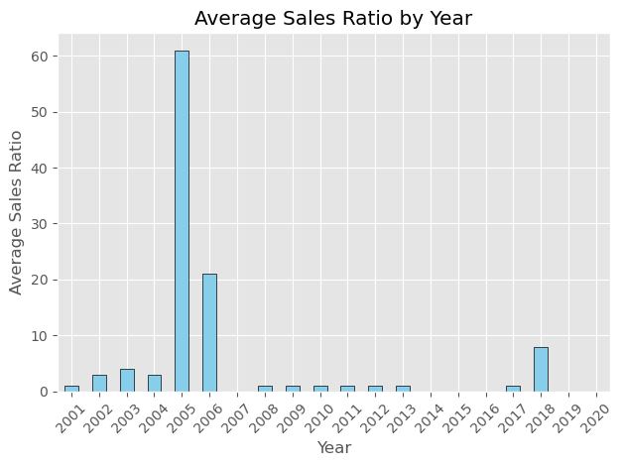
2. Analyze sales ratios to uncover trends in property market values, understanding how sale amounts relate to the assessed values across different property types and residential classifications.
From the visualization, several interesting observations emerge
High Sales Activity Years:
The data indicates that 2005 stands out as the year with the highest sales activity, recording 61 sales ratios. This suggests that 2005 was a robust year for real estate transactions. Following 2005, the years 2006, 2018, and 2003 also show notable sales activity, albeit to a lesser extent, with 21, 8, and 4 sales ratios, respectively.
Low Sales Activity Years:
On the other end of the spectrum, several years, including 2014, 2015, 2016, 2007, 2019, and 2020, recorded no sales ratios at all. This indicates periods of minimal or zero real estate transactions, possibly reflecting market downturns, economic challenges, or other factors impacting buyer and seller activity.
Data Scientist/Analyst

Slide 9
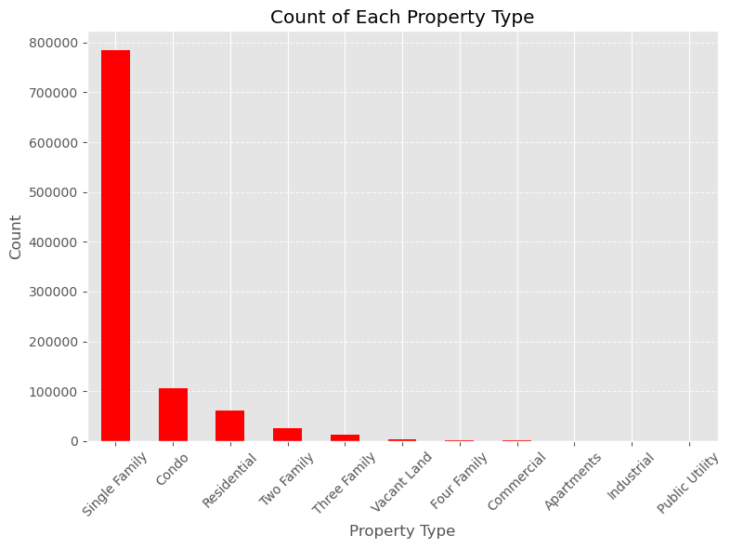
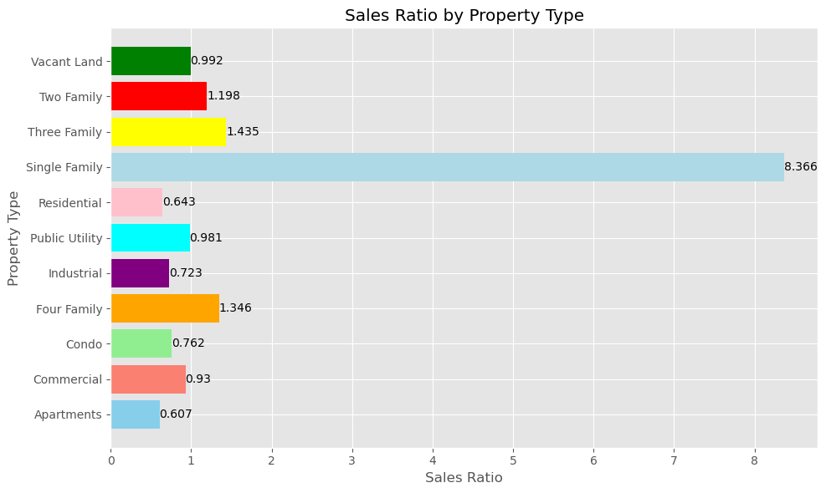
Univariate and Bivariate Analysis: Count of Property Type & Sales Ratio by Property Type
The chart indicates that Single Family Homes have the highest count among property types and a higher sales ratio, implying a potential premium in assessed value and sale amount. This suggests a robust demand for Single Family Homes.

Slide 10
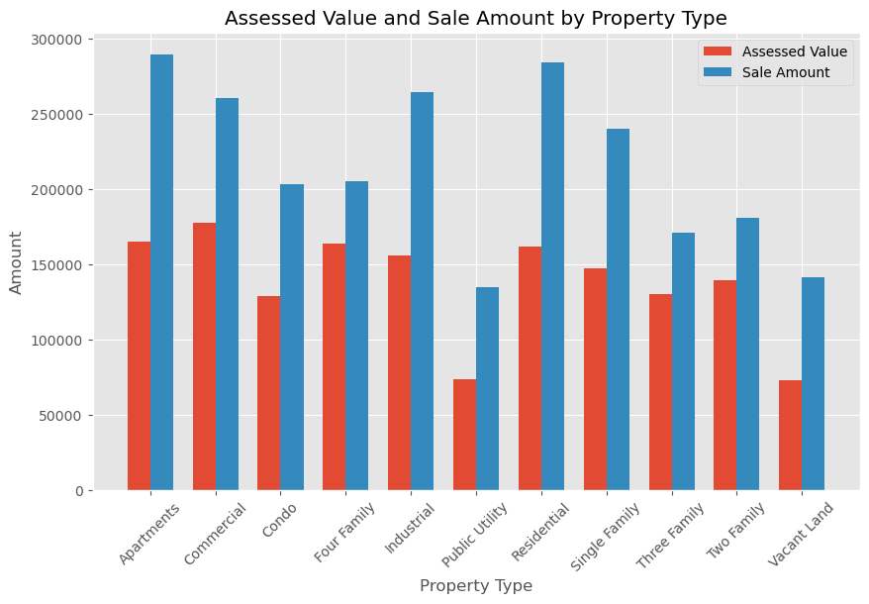
Explore Sale Amount vs. Assessed Value Across Different Property Types
Assessing Property Values
The chart shows the comparison of Assessed Values and Sale Amounts by Property Type. Apartments, residential properties, and single-family homes have higher assessed values compared to other property types, while public utility properties and vacant land have lower assessed values.
Sale Amounts Analysis:
Apartments and residential properties show higher sale amounts, indicating strong market demand and value. Condos, single-family homes, and commercial properties also have substantial sale amounts, slightly below apartments and residential properties.
Discrepancies and Trends:
There are variations in the relationship between assessed values and sale amounts across different property types. While some property types, such as apartments and residential properties, demonstrate a relatively consistent relationship between assessed values and sale amounts, others may exhibit discrepancies.

Slide 11
Recommendations
Data Scientist/Analyst
Determine which factors have the most significant impact on sales ratios and overall market trends.
Consider potential policy interventions or market interventions to address any identified challenges or issues.

Slide 12
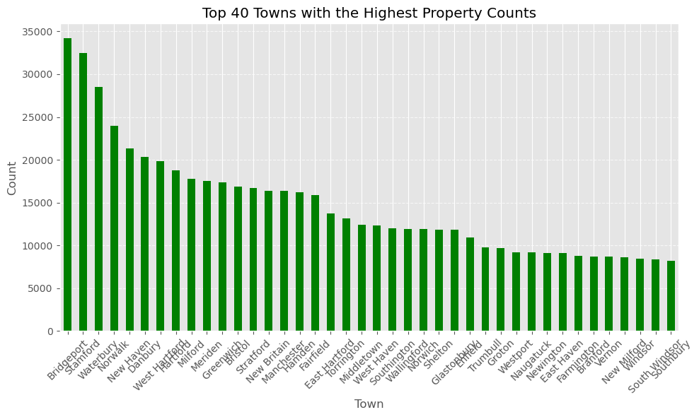
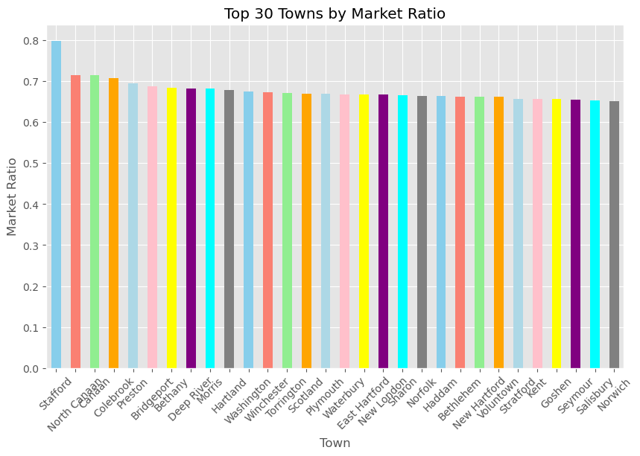
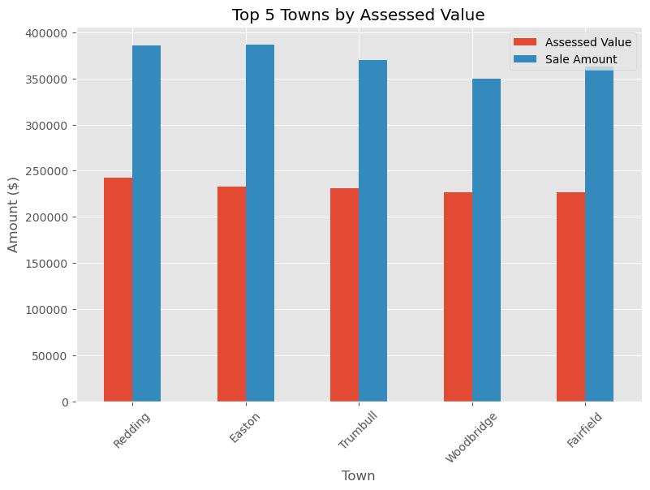
3 Geographical Analysis Investigate variations in assessed values, sales amounts, and market ratios across different towns, providing a localized understanding of real estate dynamics.
The chart illustrates the top 5 towns based on their assessed property values and sale amounts, providing insights into the real estate market in the area. Additionally, the chart displays the market ratios of the top 30 towns, indicating the relationship between property values and sale prices in each town.
A higher market ratio suggests that property values are relatively higher compared to sale prices, while a lower ratio may indicate more affordable property prices.
The dataset reveals a wide range of property counts across different towns, with Bridgeport leading with the highest number of properties, followed by Stamford and Waterbury, reflecting urban centres with large populations and high real estate activity.

Slide 13
Recommendations
Based on the information provided in the combined text, here are some recommendations:
1. Investment Focus: Consider investing in towns with high market ratios as they may indicate potential for property value appreciation. Conduct further research on towns like Stafford, North Canaan, and Bridgeport to explore investment opportunities.
2. Market Analysis: Conduct a detailed market analysis of the top 5 towns with assessed property values and sale amounts to understand the trends driving property values in those areas. This analysis can help in making informed decisions regarding real estate investments.
3. Diversification: Diversify your real estate portfolio by considering towns with varying property counts. Explore investment opportunities in towns like Bridgeport, Stamford, and Waterbury, which have high property counts and are likely to offer a range of real estate options.
4. Urban Development: Given that Bridgeport, Stamford, and Waterbury are identified as urban centers with high property counts, monitor urban development projects and infrastructure improvements in these areas. These factors can significantly impact property values and rental demand.
5. Risk Management: Assess the risk associated with investing in towns with different market ratios and property counts. Consider factors such as economic stability, population growth, and local amenities to make well-informed investment decisions.

Slide 14
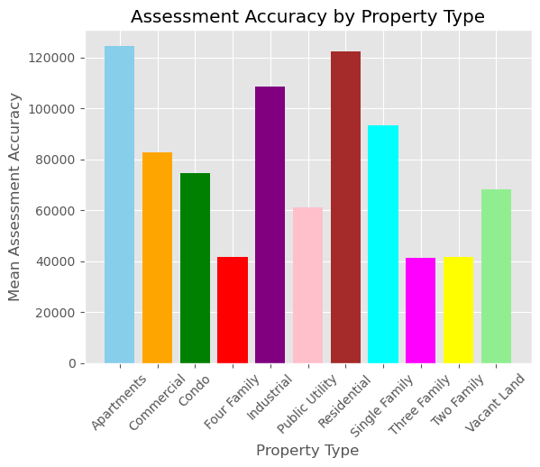
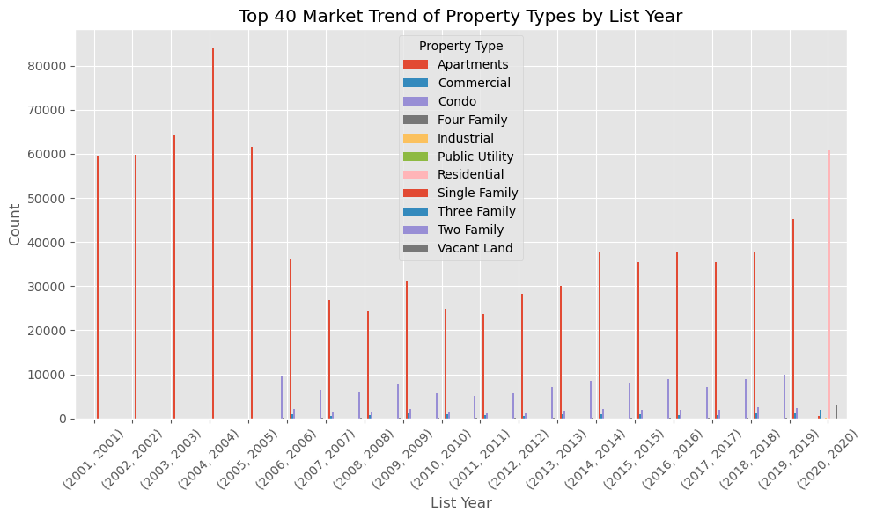
4 Property Type Impact Examine the impact of property type on assessment accuracy and market trends, exploring whether certain types (e.g., residential, commercial) exhibit distinct patterns.
The first chart discusses the accuracy of property assessments by property type, highlighting the mean assessment accuracy for each category. This information offers insights into how well the assessed values align with the actual values of properties within each type.
The second chart delves into the changing trends in the property market over the years for various property types. It showcases the annual count of properties listed for sale from 2001 to 2020 across categories like Apartments, Commercial properties, Condos, Single Family homes, and Vacant Land. Analyzing this data provides valuable insights into the evolving dynamics of the real estate market and trends in property listings.

Slide 15
Recommendations
Based on the combined information provided, here are some recommendations:
Assessment Accuracy Improvement: Evaluate the property assessment processes, especially for property types where the mean assessment accuracy is lower. Implement measures to enhance the accuracy of property assessments to ensure that assessed values align more closely with actual property values.
Market Trend Analysis: Analyze the trends in property listings over the years for different property types. Identify patterns and fluctuations in listing activity to understand market dynamics better. This analysis can help in making informed decisions regarding property investments and market trends.
Investment Strategy: Use the insights from the assessment accuracy and market trend data to refine your investment strategy. Focus on property types with higher assessment accuracy and consider market trends when making investment decisions in real estate.
Diversification: Diversify your real estate portfolio across different property types based on the assessment accuracy and market trends. Spread investments across property categories to minimize risk and take advantage of varying market conditions.
Continuous Monitoring: Continuously monitor property assessment accuracy and market trends to stay updated with the changing dynamics of the real estate market. Regularly review and adjust your investment strategy based on new data and market developments.
Data Scientist/Analyst

Slide 16
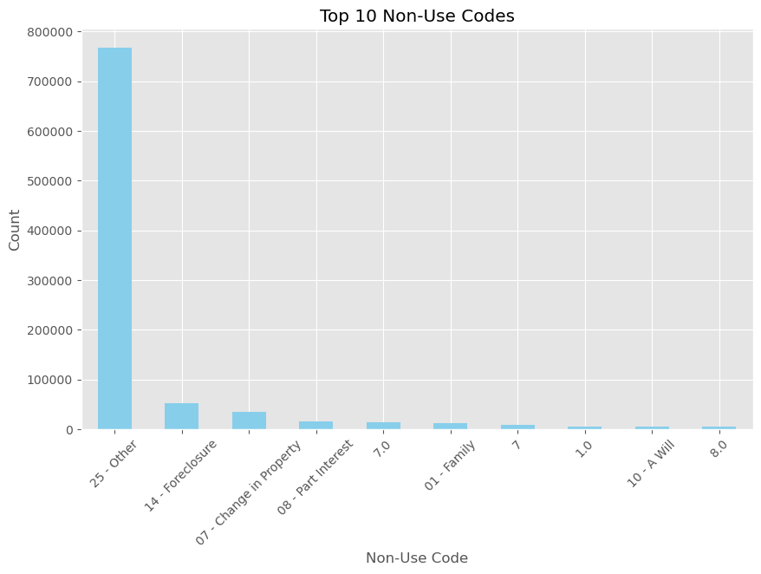
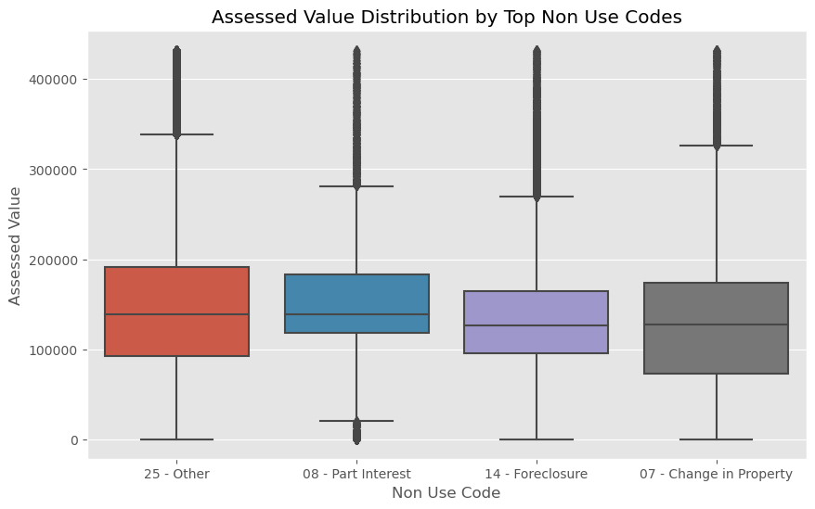
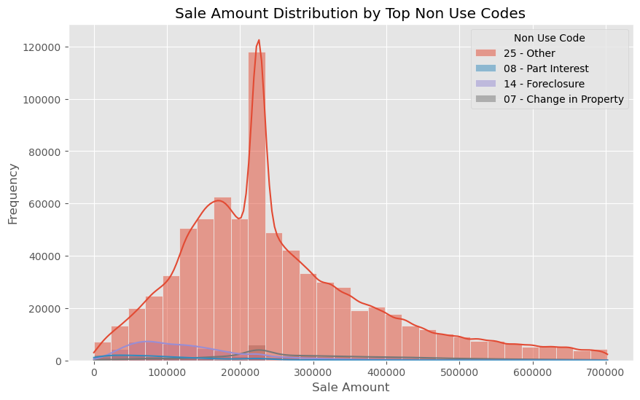
5 Non-Use Code Insights Explore the significance of non-use codes in property assessment, investigating how these codes influence assessed values and sales transactions.
The data story explores the relationship between non-use codes and property values by analyzing the distribution of sale amounts across specific non-use code categories. It sheds light on how different circumstances or conditions captured by non-use codes impact the assessed values and sale prices of properties within these categories.
Non-use codes, such as "Other," "Foreclosure," "Part Interest," and "Change in Property," are utilized in property records to categorize unique situations that may influence property values. By examining the frequency of these non-use codes, valuable insights are gained into the diverse reasons or conditions that affect properties within the dataset, providing a comprehensive understanding of the factors influencing property assessments and sale prices.

Slide 17
Recommendations
Analysis of Non-Use Code Impact: Conduct a detailed analysis to understand how different non-use codes, such as "Other," "Foreclosure," "Part Interest," and "Change in Property," impact property values and sale amounts. Identify trends and patterns to assess the significance of these codes on property transactions.
Data Quality Assurance: Ensure the accuracy and consistency of non-use code assignments in property records. Implement quality assurance measures to verify that non-use codes are applied correctly and uniformly to maintain data integrity.
Comparative Analysis: Compare the distribution of sale amounts and assessed values across non-use code categories to identify any discrepancies or trends. This analysis can help in understanding the relationship between non-use codes and property valuations.
Data Scientist/Analyst

Slide 18
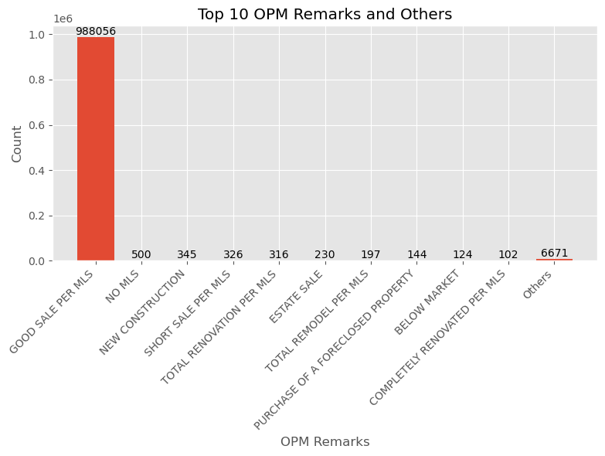
6 Assessor and OPM Remarks Analyze remarks provided by assessors and the Office of Policy and Management (OPM) to identify factors influencing assessment decisions and potential areas for improvement.
The chart presents the top 10 OPM (Office of Property Management) remarks and other categories along with the frequency of each remark. These remarks represent specific conditions or characteristics related to properties, such as "NO MLS," "ESTATE SALE," "NEW CONSTRUCTION," "SHORT SALE PER MLS," and others.
The data provides information on the prevalence of these remarks in property management records, indicating the various types of property transactions, statuses, or conditions associated with the properties mentioned in the dataset.
Data Scientist/Analyst

Slide 19
Recommendations
Data Scientist/Analyst
Analysis of Remark Impact: Analyze the impact of OPM remarks on property transactions and management. Investigate how remarks like "NO MLS," "ESTATE SALE," "NEW CONSTRUCTION," and others influence property values, market perception, and transaction processes.
Understanding Property Conditions: Gain a deeper understanding of the different property conditions and statuses represented by OPM remarks. Explore the implications of remarks such as "SHORT SALE PER MLS," "TOTAL RENOVATION PER MLS," and "COMPLETELY RENOVATED PER MLS" on property valuations and market positioning.
Market Trend Analysis: Conduct a trend analysis to identify patterns and correlations between OPM remarks and property transactions over time. Identify any recurring trends or changes in the prevalence of specific remarks to anticipate market dynamics.

